Slide 1
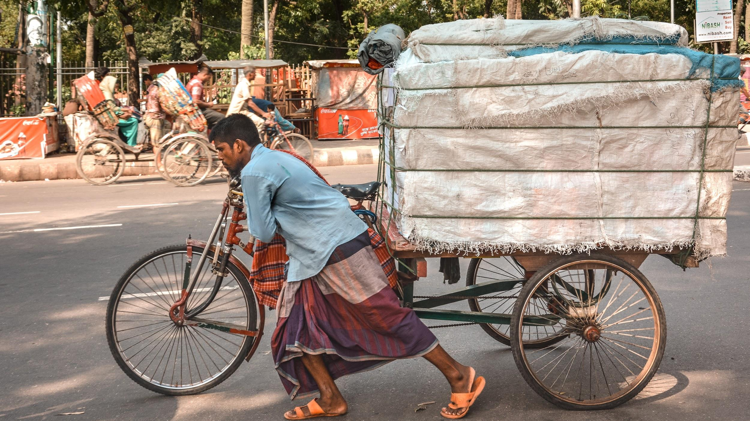
INTRODUCTION TO FORCES
We will describe the effect of forces on familiar objects.
Notes:
Insert cover image and use transparency settings to fade image.

Slide 2
Do not delete this slide.
This slide is designed so that you can copy the prompt box you need and insert it into your slides.
This slide is hidden and will not be included when presenting your lesson.
TRACK WITH ME
VOCABULARY
1 -
HINT
Students, remember….
CHECK FOR UNDERSTANDING
READ WITH ME
TEACHER CUE
MAKE THE CONNECTION
Students, you already know….
EXTENSION
GESTURE WITH ME

Slide 3

1. Complete this sentence:
The study of physics is __________________________________________________________________
2. Draw a picture aid your description of ‘the study of physics’

Slide 4
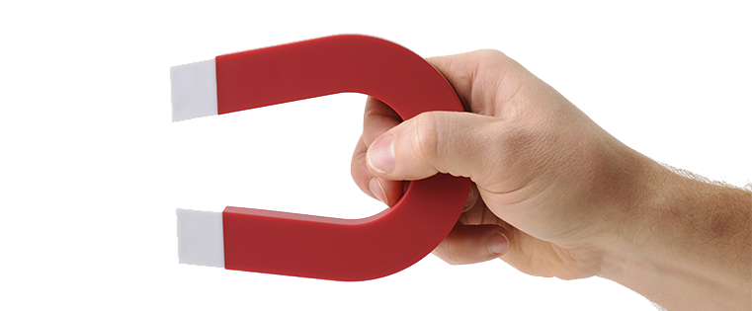
How many separation techniques can you remember? List them.

Slide 5
Repeat the opposite word/phrase.
INDEPENDENT VARIABLE
WHAT IS CHANGED IN THE EXPERIMENT

Slide 6
Repeat the opposite word/phrase.
DEPENDENT VARIABLE
WHAT IS MEASURED AND CHANGES

Slide 7
Repeat the opposite word/phrase.
CONTROLLED VARIABLE
WHAT ARE KEPT THE SAME

Slide 8
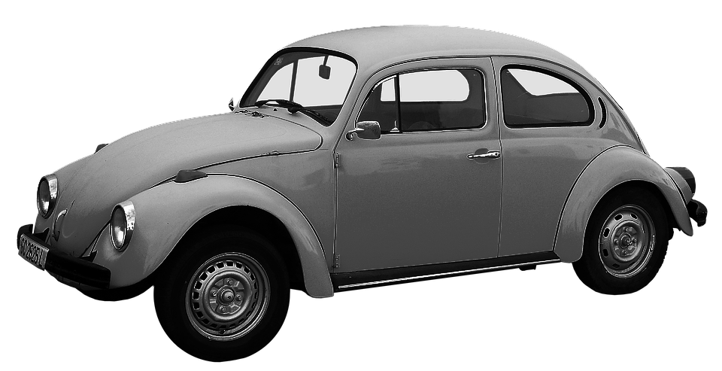
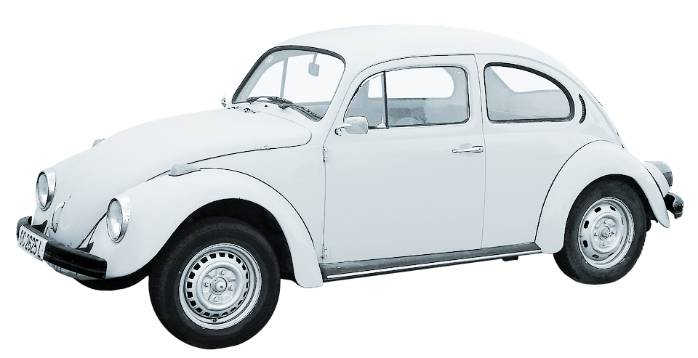
In this experiment, a grey car and a white car were parked in the sun. The temperature of each car was measured throughout the day to see which colour would heat up faster.
What is the independent variable?
What is the dependent variable?
List at least two controlled variables

Slide 9
We will investigate forces
TRACK WITH ME
READ WITH ME
We will define force.
We will summarise the five effects of forces on objects.
Describe the effect of forces on everyday objects
DECLARE THE OBJECTIVE
Read the learning objective to your partner.
Notes:
Learning Objectives contain concepts (nouns, big ideas), skills (verbs, measurable behaviours) and sometimes context (restricting or targeting conditions).
●Example: Students will be able to describe the concept of density and apply it to floating and sinking.
●
Success criteria are specific measurable outcomes that if met mean that the student has met the learning objective.
Examples:
•Students will be able to compare densities of substances using mass and volume.
•Students will be able to identify whether a solid or liquid will float or sink in a liquid based on their densities.

Slide 10

We will describe the effect of forces on familiar objects.
You have probably heard the word force before.
How have you heard this word used?
In Science the word force means a push, pull or twist on an object.
MAKE THE CONNECTION
What words do we associate with the word force?

Slide 11
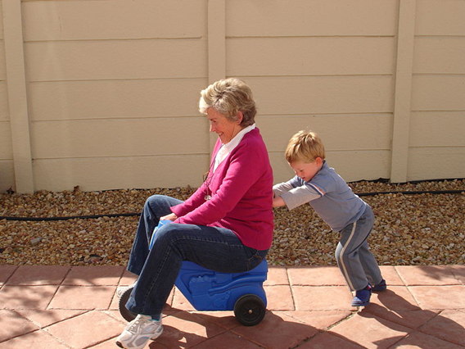
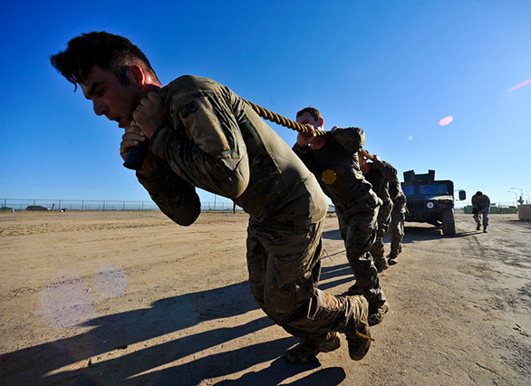
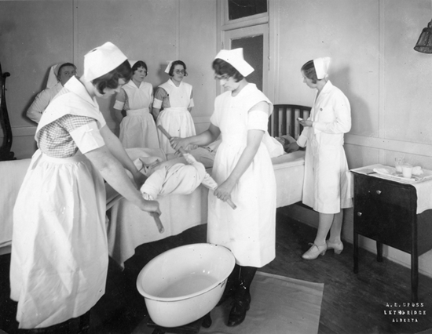
We will describe the effect of forces on familiar objects.
GESTURE WITH ME
CHECK FOR UNDERSTANDING
What is a force? Can you see forces?
In Science a force is a push, pull or twist acting on an object.
You cannot see forces, but you can see their effect.

Slide 12
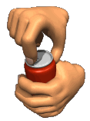
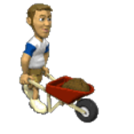
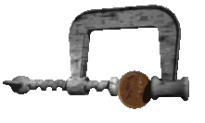
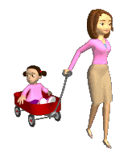
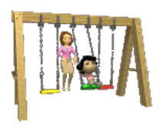
We will describe the effect of forces on familiar objects.
Which two images show the force push?
1
2
3
4
5

Slide 13
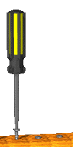
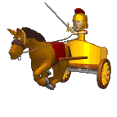
We will describe the effect of forces on familiar objects.
Which three images show the force pull?
1
2
3
4
5

Slide 14
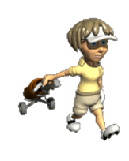
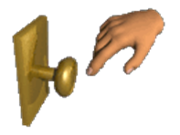
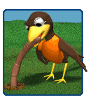
We will describe the effect of forces on familiar objects.
Which two images show the force twist?
1
2
3
4
5

Slide 15
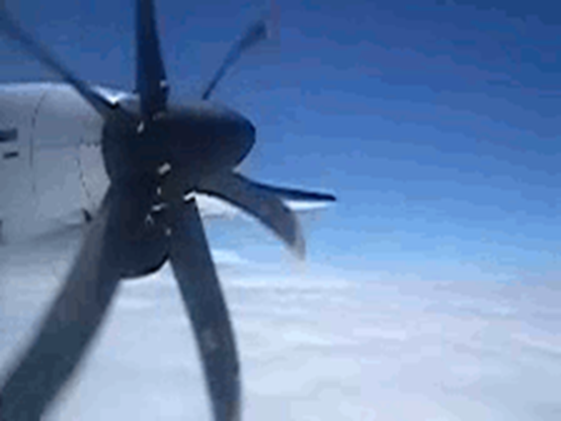

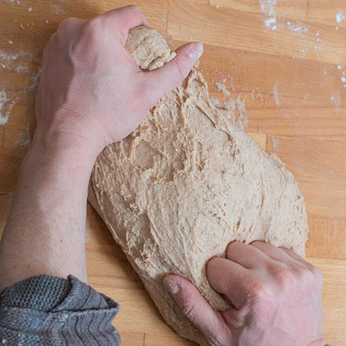
We will describe the effect of forces on familiar objects.
CHECK FOR UNDERSTANDING
What are the five things that a force can do? Which picture below shows a force turning something?
A force₁ can:
Move something (acceleration)
Stop something moving (deceleration)
Change something’s direction
Turn something
Change something’s shape
B
VOCABULARY
1- a push, pull or twist.
C
A

Slide 16
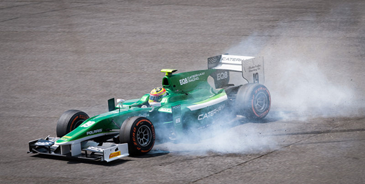
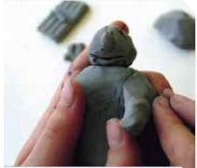
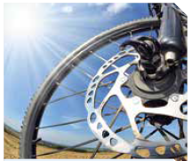
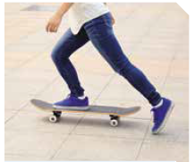
We will describe the effect of forces on familiar objects.
Match the image to one of the five things that forces can do.
Move something (acceleration)
Stop something moving (deceleration)
Change something’s direction
Turn something
Change something’s shape
E
A
B
C
D

Slide 17

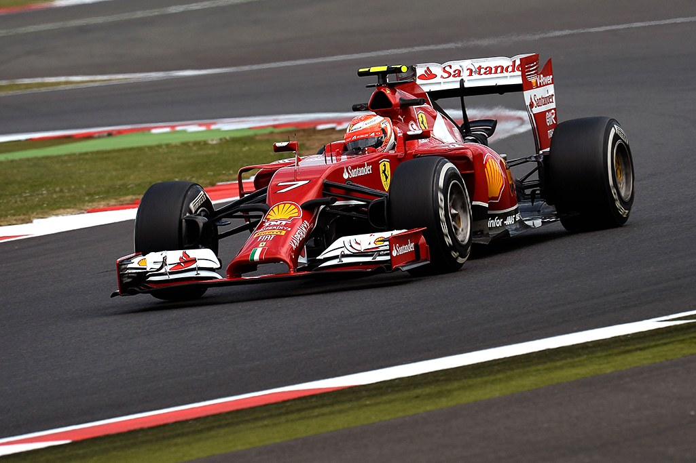
We will describe the effect of forces on familiar objects.
CHECK FOR UNDERSTANDING
When are forces present?
Forces₁ act on everything around us all the time.
Forces₁ are present whenever anything is moving. So understanding forces₁ is vital to top level sports.
For example Olympic swimmers wear compression suits that allows the water to glide past them, instead of creating drag and slowing them down.
Rear spoilers in racing create a downward force that allows the car to accelerate quickly without the front lifting because of their light weight.
VOCABULARY
1 - a push, pull or twist

Slide 18

We will describe the effect of forces on familiar objects.
Describe what is happening in this picture in a couple of sentences.
Is the runner using any forces? Are there any forces acting on him?

Slide 19
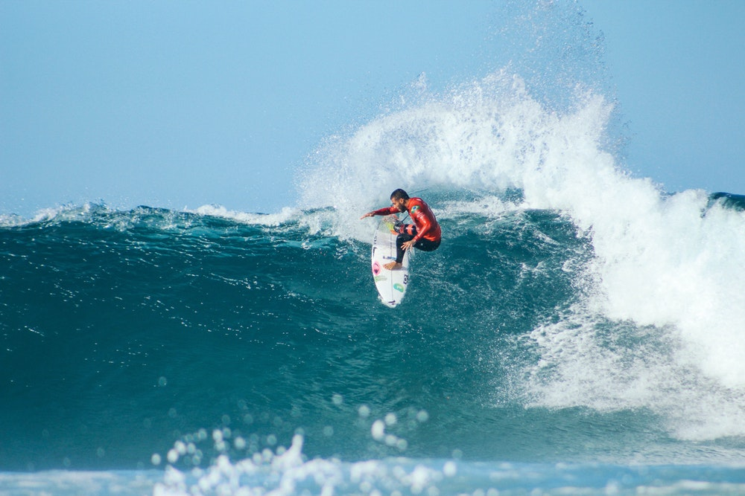

We will describe the effect of forces on familiar objects.
Answer the following questions in your book.
What is a force?
What five things can forces do?
Extension: How are the forces of push, pull and twist present in surfing?
3 minutes
Notes:
Please include tasks/questions here rather than just referring to a worksheet. This will save on photocopying and facilitate sharing with other schools.
Try and build tasks/questions which escalate through Bloom’s Taxonomy. This will help with differentiation.

Slide 20
We will describe the effect of forces on familiar objects.
We will define force.
We will summarise the five effects of forces on objects.
CHECK FOR UNDERSTANDING
Check Success Criteria.
Notes:
Learning Objectives contain concepts (nouns, big ideas), skills (verbs, measurable behaviours) and sometimes context (restricting or targeting conditions).
●Example: Students will be able to describe the concept of density and apply it to floating and sinking.
●
Success criteria are specific measurable outcomes that if met mean that the student has met the learning objective.
Examples:
•Students will be able to compare densities of substances using mass and volume.
•Students will be able to identify whether a solid or liquid will float or sink in a liquid based on their densities.

